Slide 1


Slide 2
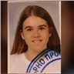
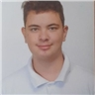
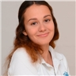
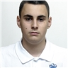
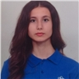

Participants
Kamelya
Yaneva IX G
Kaloyan Pazlamachev IX B
Petya
Petkova IX V
Andrey
Andreev IX G
Vesela
Dekova IX A

Slide 3


Everyone’s work

Slide 4

Theme

Slide 5







Used technologies

Slide 6

Organization time

Slide 7

Future ideas

Slide 8
Video of our project

Slide 9
Thanks For
Your Attention

